Slide 1
indexes

Slide 2
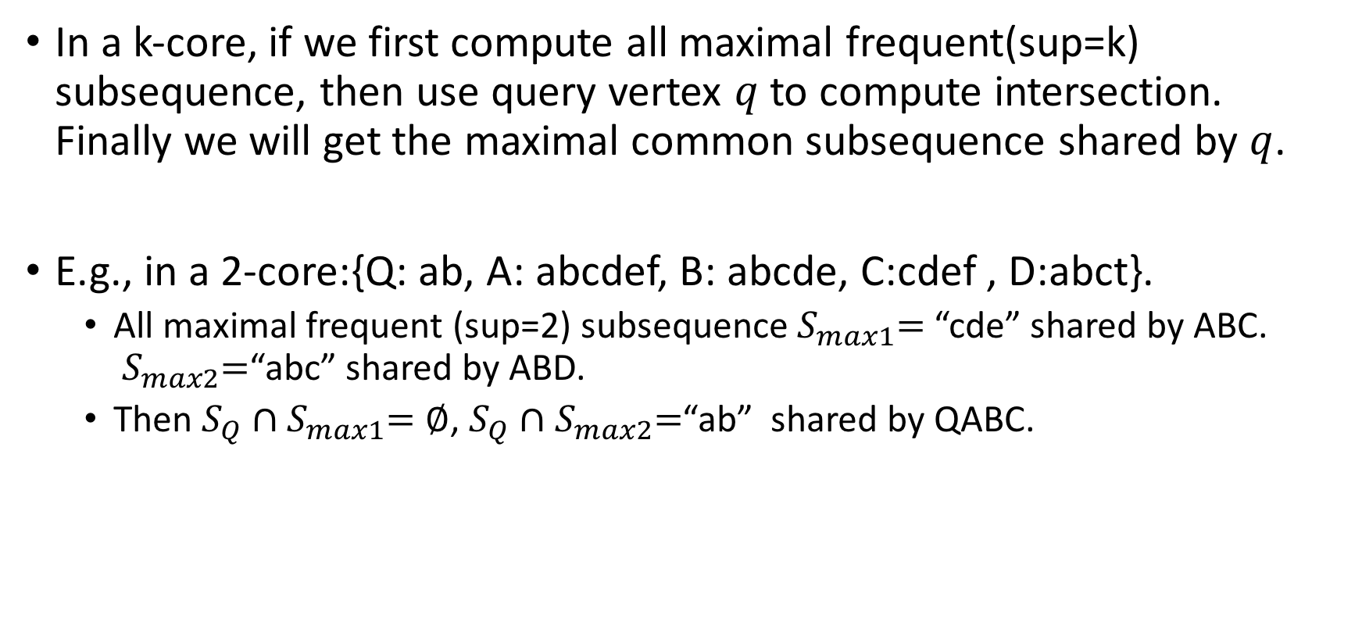
Observation 1 (from sequence)
In a k-core, if we first compute all maximal frequent(sup=k) subsequence, then use query vertex $q$ to compute intersection. Finally we will get the maximal common subsequence shared by $q$.
E.g., in a 2-core:{Q: ab, A: abcdef, B: abcde, C:cdef , D:abct}.
All maximal frequent (sup=2) subsequence${ S}_{max1}=$ “cde” shared by ABC. ${ S}_{max2}=$“abc” shared by ABD.
Then $S_{Q}∩{ S}_{max1}=∅$, $S_{Q}∩{ S}_{max2}=$“ab” shared by QABC.

Slide 3
One strategy(index 1)
Step 1: Compute all k-cores.
Step 2: For each k-core, pre-compute all maximal frequent (sup=k) subsequences and store it.
While querying, get intersection with them.

Slide 4
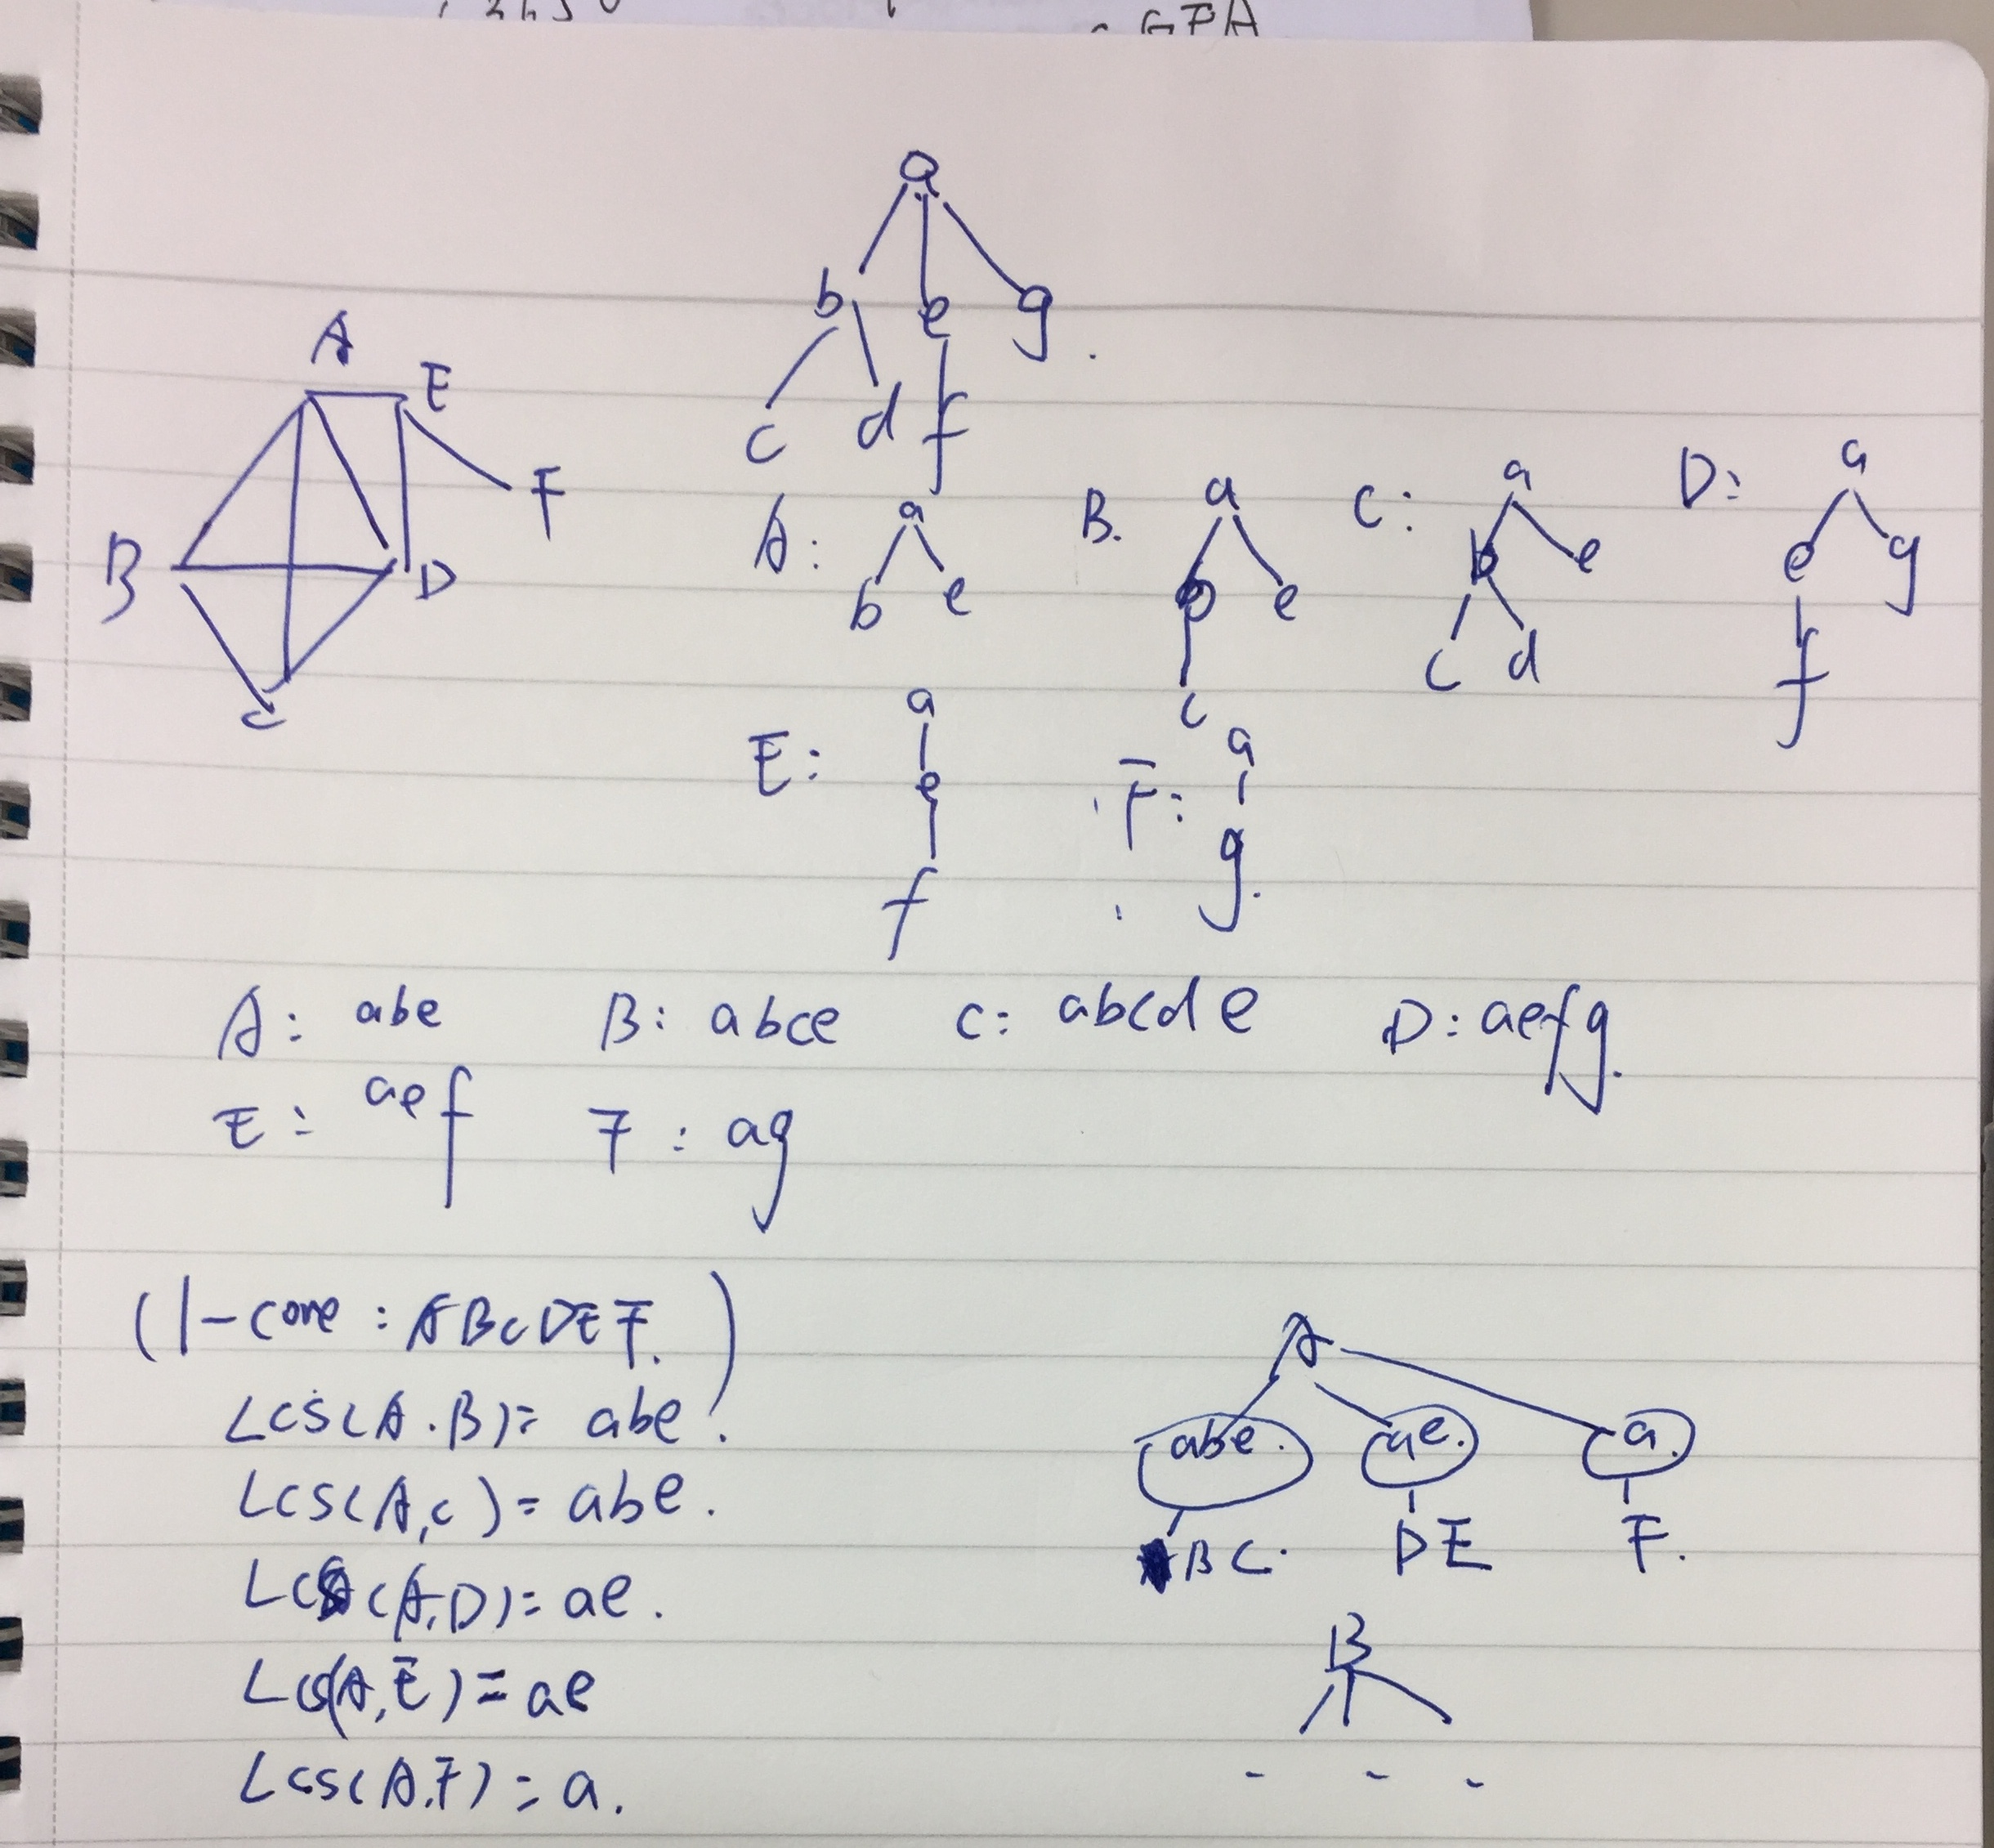
Trade-off
In step 2: For each k-core, pre-compute all maximal frequent (sup=k) subsequences and store it.
We do not pre-compute all maximal frequent subsequences. We do longest common subsequence for each vertex.

Slide 5
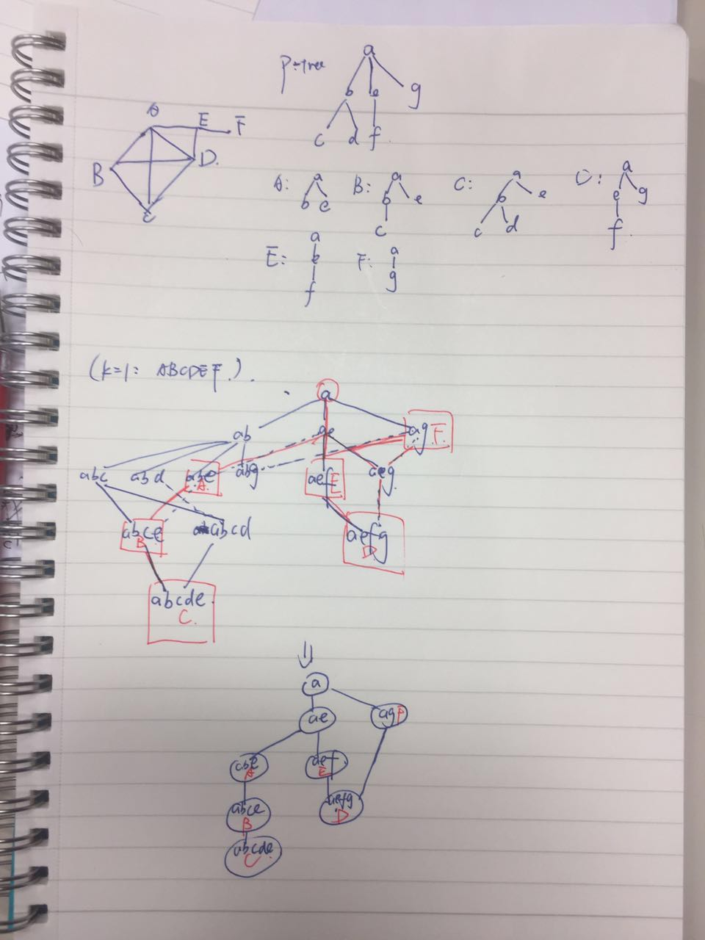
Observation 2(from tree) index2
If we focus on the relationship of subsequences.
Step 1 : We can enumerate all possible subsequences. We call it enumeration lattice.
Step 2 : vertex’s sequence can be located in one of enumeration lattice.

Slide 6
Step 3: We can compress an enumeration lattice to omit some redundant patterns.
Details and techniques of compressing should be noticed.
While querying, low common ancestor(lca) of query vertex and targeted vertices is the maximal subsequence pattern.
E.g., in 1-core, query vertex is A, then ABC will be return. LCA pattern of {ABC} “abe” which is the maximal common subsequence.

Slide 7
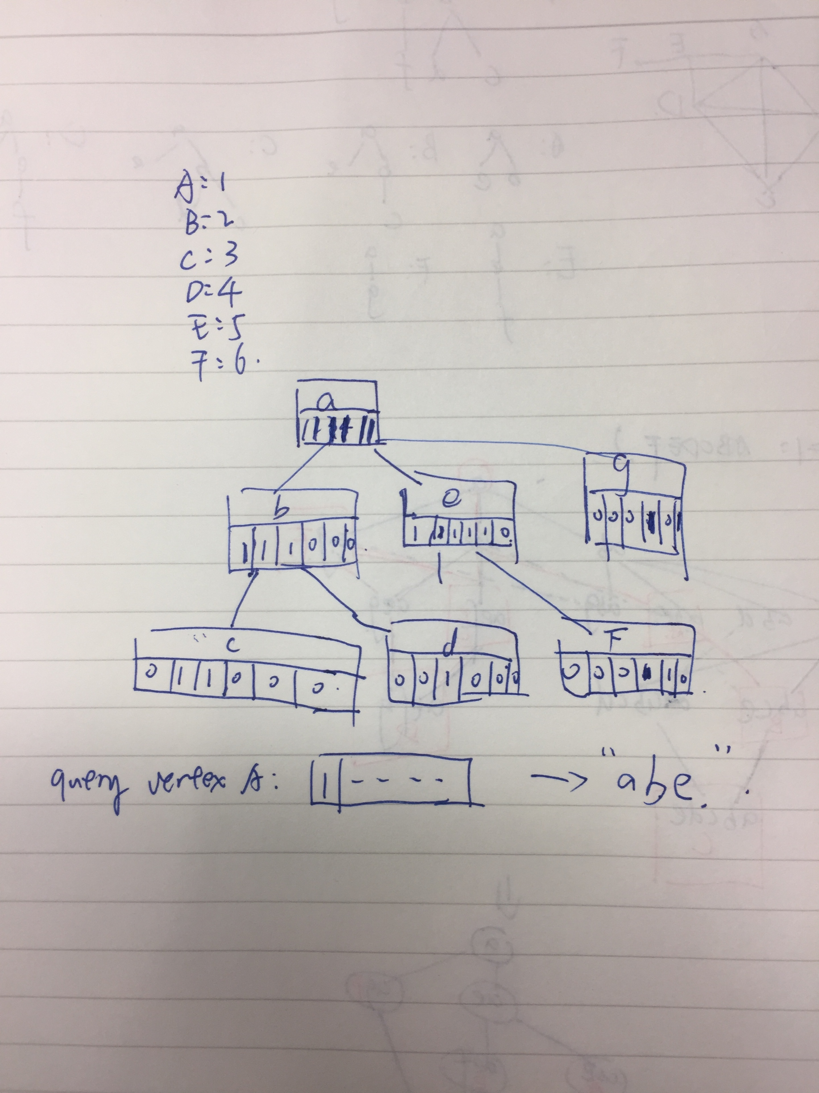
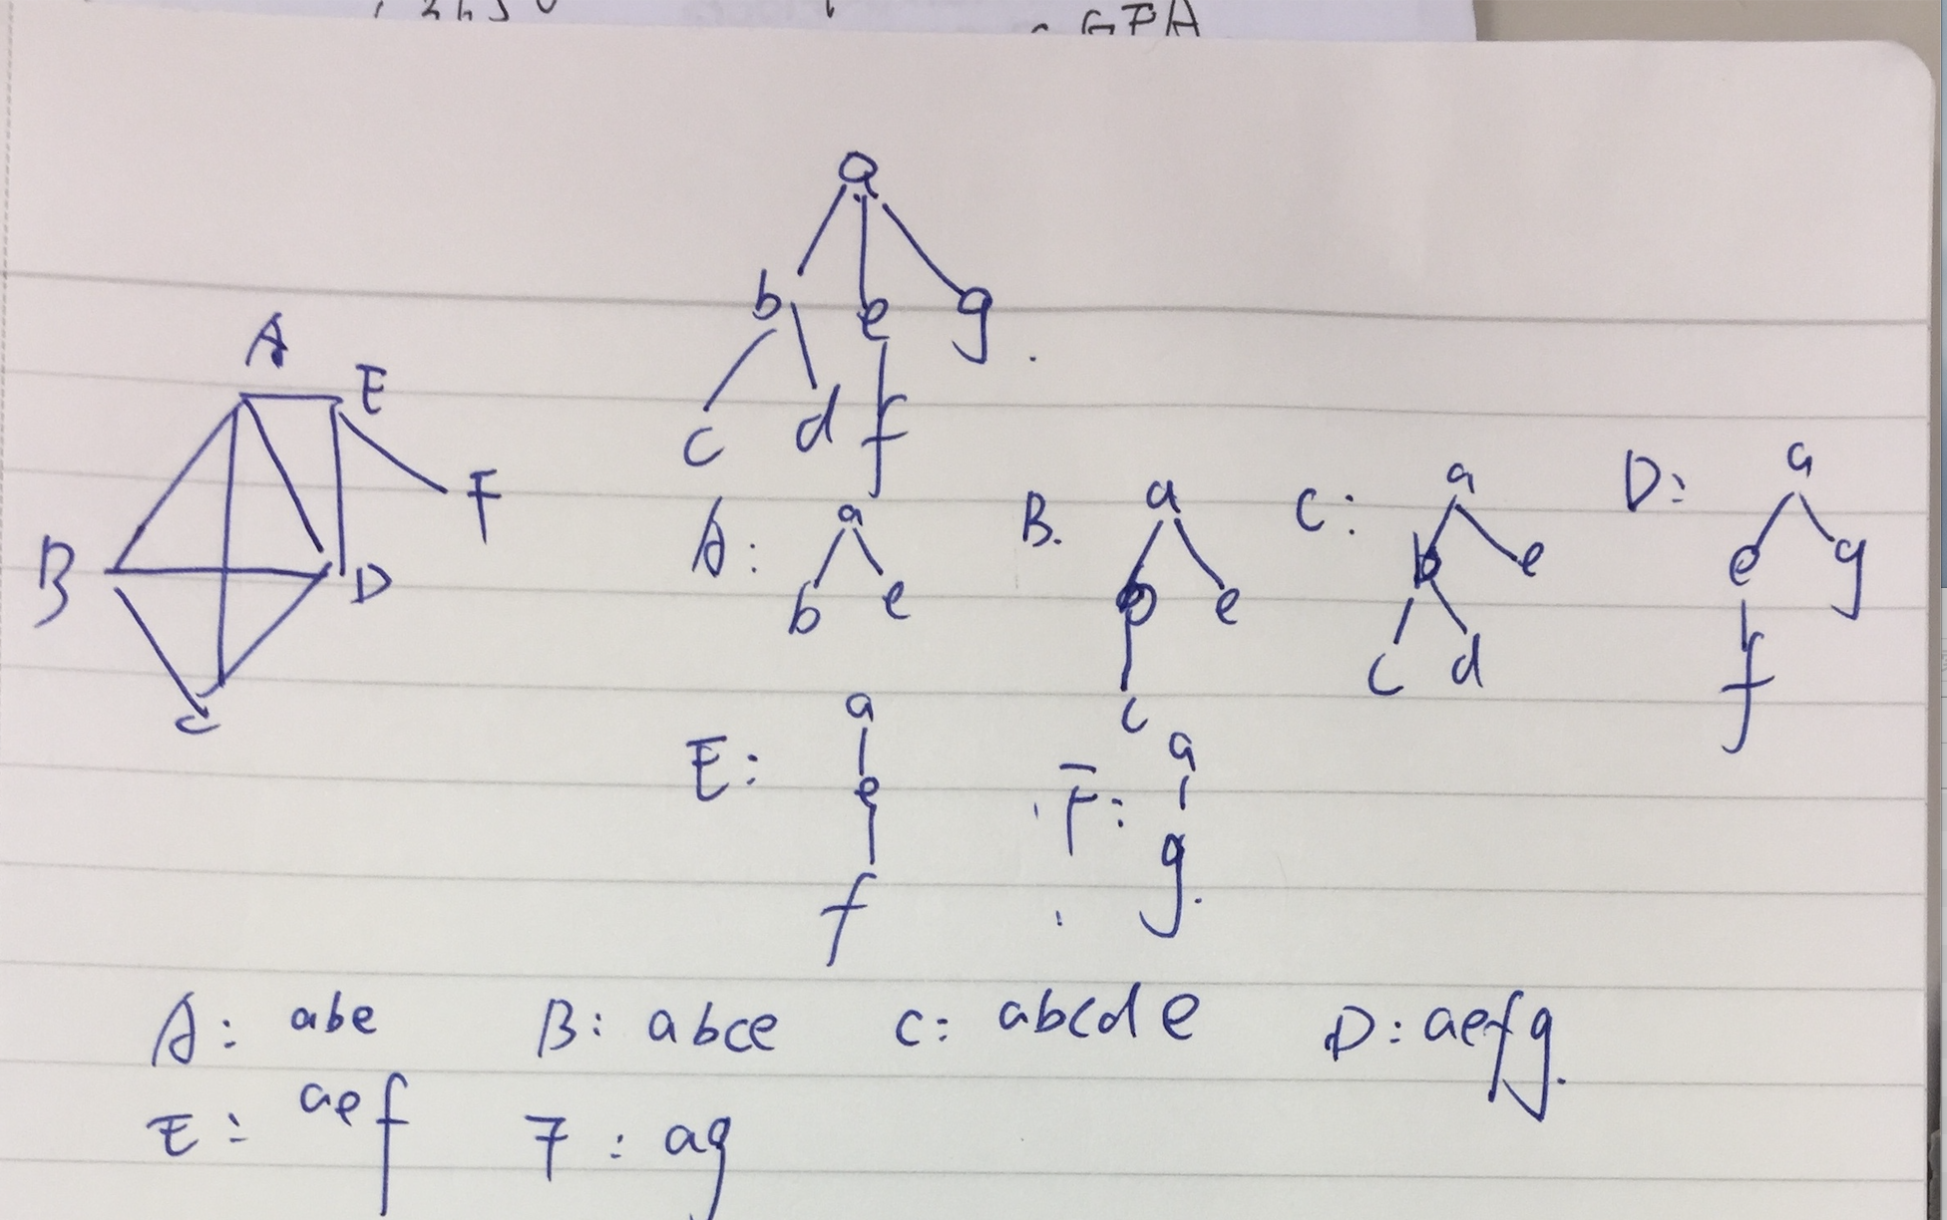
Index 3

Slide 8
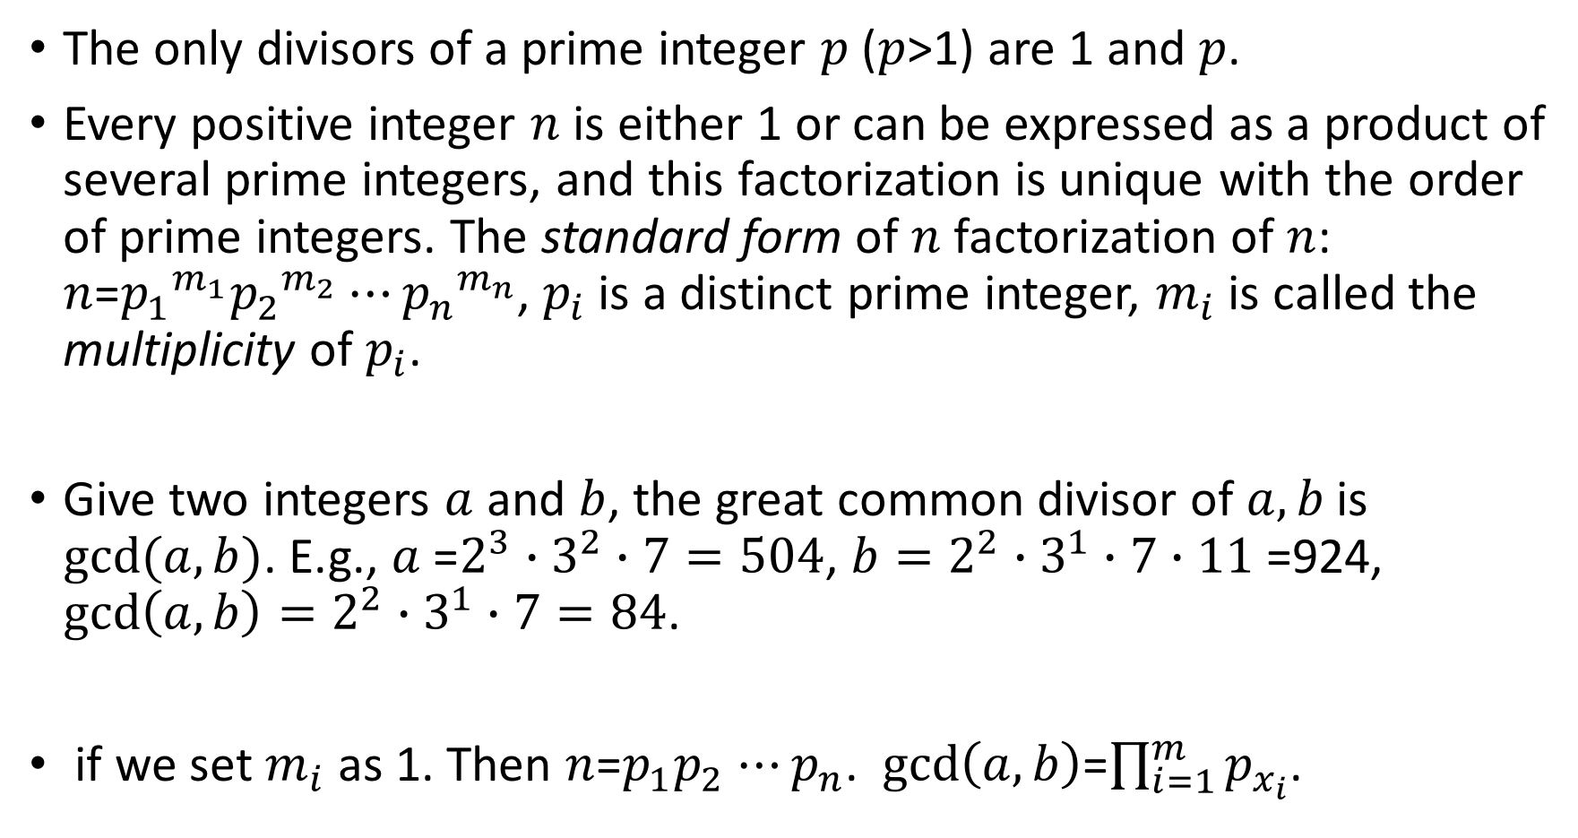
compressed index-mathematic preliminary
The only divisors of a prime integer $p$ ($p$>1) are 1 and $p$.
Every positive integer $n$ is either 1 or can be expressed as a product of several prime integers, and this factorization is unique with the order of prime integers. The standard form of $n$ factorization of $n$: $n$=${p_{1}}^{m_{1}}{p_{2}}^{m_{2}}⋯{p_{n}}^{m_{n}}$, $p_{i}$ is a distinct prime integer, $m_{i}$ is called the multiplicity of $p_{i}$.
Give two integers $a$ and $b$, the great common divisor of $a,b$ is $gcd(a,b)$. E.g., $a$=$2^{3}∙3^{2}∙7=504$, ${b=2}^{2}∙3^{1}∙7$ $∙11$ =924, $gcd\left(a,b\right)=2^{2}∙3^{1}∙7=84$.
if we set $m_{i}$ as 1. Then $n$=$p_{1}p_{2}$ $⋯p_{n}$. $gcd\left(a,b\right)$=$\prod_{i=1}^{m}{p_{x_{i}}}$.

Slide 9
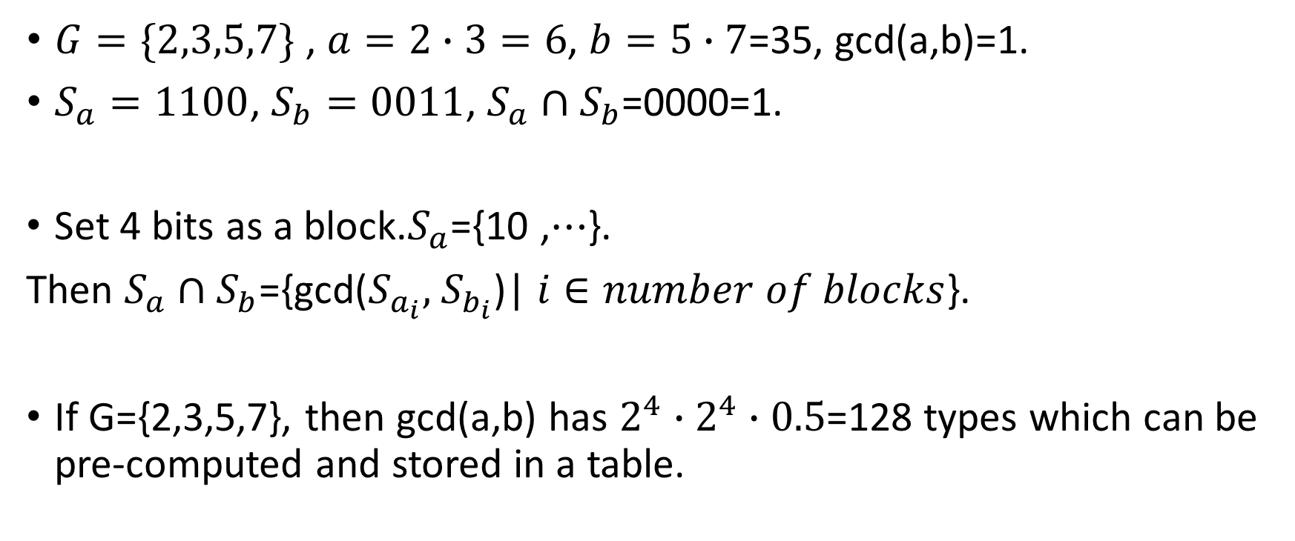
compressed index-example
$G=\{2,3,5,7\}$ , $a=2∙3=6$, $b=5∙7$=35, gcd(a,b)=1.
$S_{a}=1100$, $S_{b}=0011$, $S_{a}∩S_{b}$=0000=1.
Set 4 bits as a block.$S_{a}$={10 ,$⋯$}.
Then $S_{a}∩S_{b}$={gcd($S_{a_{i}},$ $S_{b_{i}}$)| $i∈number of blocks$}.
If G={2,3,5,7}, then gcd(a,b) has $2^{4}∙2^{4}∙0.5$=128 types which can be pre-computed and stored in a table.

